Slide 1
Antonio Sedeno-Noda, Carlos Gonzalez-Martín, “A O(nmlog(U/n)) Time Maximum Flow Algorithm,” Naval Research Logistics, Vol. 47, pp. 511-520, 2000.
第五組 陳怡璇 吳嘉文
R36964106 N88921046

Slide 2
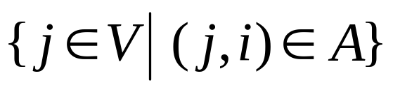

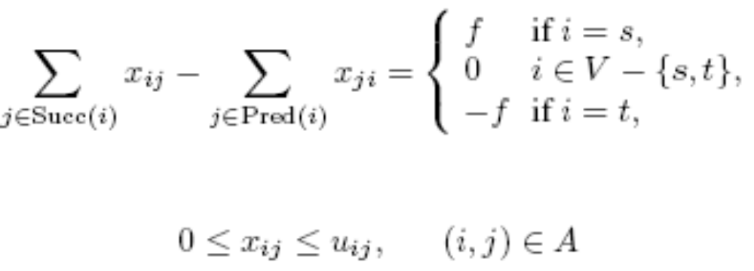
Maximum Flow Problem
directed network G = (V, A)
  V : a set of n nodes, A : the set of m arcs.
  two special nodes in G: a source node s and a sink node t
  Given any node i, Pred(i) =
  formulation

Slide 3
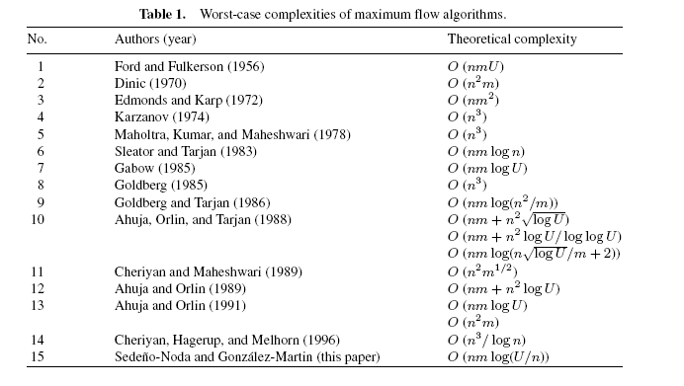
Worst-case complexities of maximum flow algorithms

Slide 4
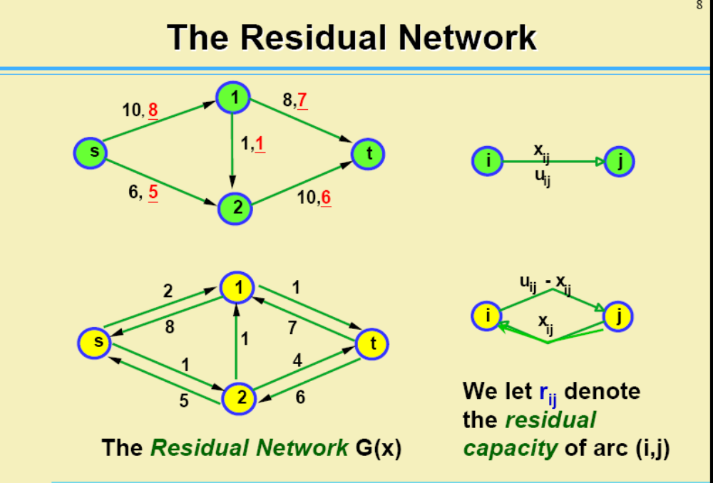
Ford and Fulkerson’s algorithm

Slide 5
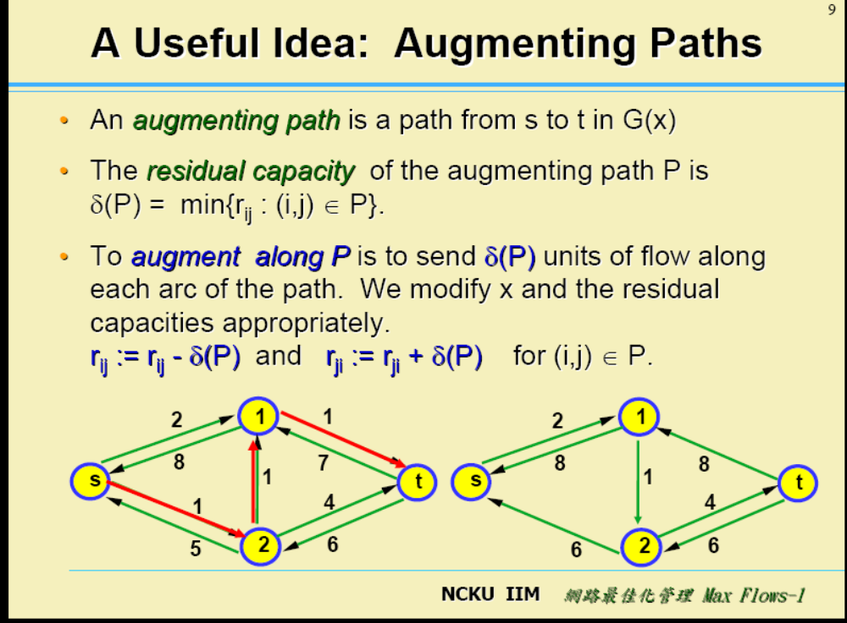
Ford and Fulkerson’s algorithm

Slide 6
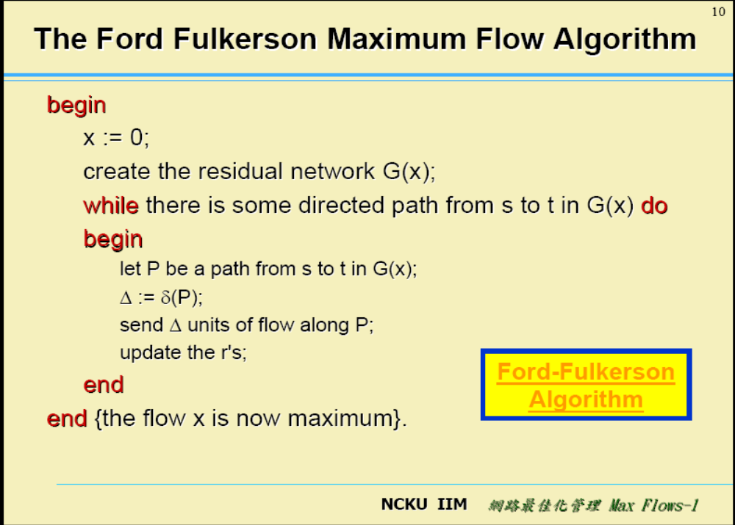
Ford and Fulkerson’s algorithm
1
U
  runs in O(nmU) time
    nU is an upper bound of the capacity of the minimum s-t cut.
    # augmentation = nU
    O(m) for identifying one augmentation path
s
U
2
U
n-1

Slide 7
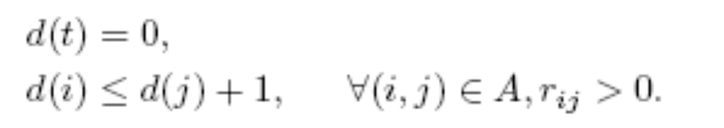

Shortest Augmenting Path Algorithm
distance label for each node in residual network
  Valid distance label
  Property 7.1: a lower bound on the length of the shortest path from node i to node t in R(x), where the length of the path is equal to the number of arcs on the path.
the distance labels are exact if,
  for each node i; d(i) equals the length of the shortest path from node i to node t in R(x),.
Property 7.2 : If d(s) n, then there is no augmenting path in R(x).

Slide 8
Shortest Augmenting Path Algorithm
arc (i,j) is admissible if d(i) = d(j) + 1
admissible path
  a path from node s to node t consisting entirely of admissible arcs
  Property 7.3: an admissible path is a shortest augmenting path from node s to node t

Slide 9
Algorithm Shortest Augmenting Path;
begin
X := 0; d(t) := 0; i := s;
Obtain the exact distance labels by a reverse breadth-first
search of the residual network starting from the sink node t;
While d(s) < n do
if i has an admissible arc then
Advance(i);
if i = t then
Augment;
i := s
end
end
else
Retreat(i)
end

Slide 10
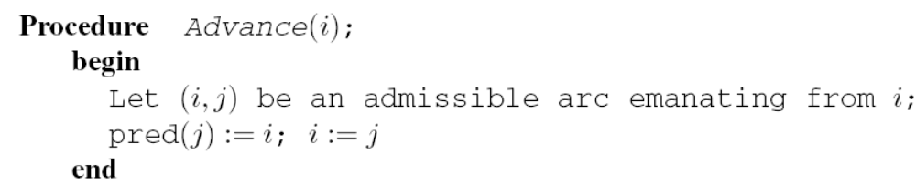
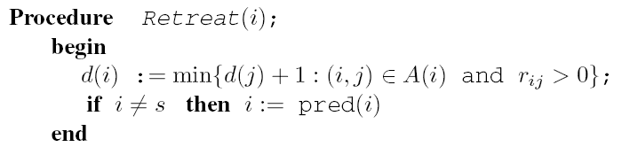
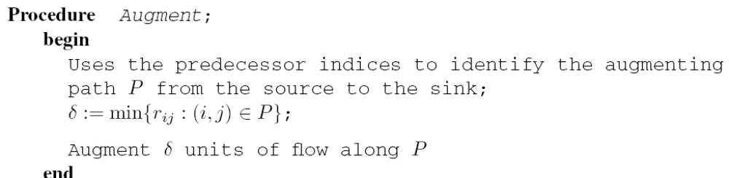

Slide 11
Complexity of Shortest Augmenting Path Algorithm
Bound the retreats, and the time for retreats
  O(n²) retreats, O(nm) time.
Bound the number of augmentations, and the time to carry out the augmentations
  O(nm) augmentations
  O(n²m) arcs in augmentations
  O(n²m) time.
Bound the time spent looking for augmentations.
  O(n²m) time spent identifying the arcs in augmentations.

Slide 12
Capacity Scaling Algorithm
Definitions
  ∆-residual network, R (∆)
    The network that contains only those arcs whose residual capacity is at least ∆.
  ∆-optimal
    in the network R(x) there is no augmenting path of
    residual capacity of at least ∆

Slide 13
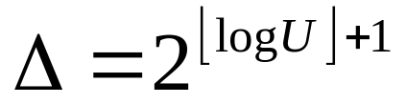
Capacity Scaling Algorithm
∆-scaling phase
  starts with a fixe ∆ and obtains a ∆-optimal flow
  Initially,
  After obtaining a ∆-optimal flow, let ∆ = ∆ /2
    In the last phase, ∆ = 1.
    R(∆) = R(x)
    at the end of the last phase, a maximum flow is obtained.

Slide 14
2-phase Capacity Scaling Algorithm
In each ∆-scaling phase, 2 phases are performed to obtain the ∆-optimal flow of R(∆)
  shortest augmentation path algorithm
    enforce each augmentation to send exactly ∆ flow units
  Ford and Fulkerson algorithm
    while identifying the augmentation path, modify the depth-first search in such a way that only the arcs whose residual capacities are at least ∆ are considered.

Slide 15
Phase 1: shortest augmentation path algorithm
different stopping rule
  d(s) k(∆)
    Original stopping rule: k(∆) = n
    If k(∆) < n, then the phase 1 procedure does not guarantee an ∆-optimal flow
augment exactly ∆ flow units
  Advance through arc (i,j), residual capacities of the arcs (i; j) and (j; i) are updated
    r_{ij} = r_{ij} − ∆ and r_{ji} = r_{ji} + ∆
  When Retreat a node, the residual capacities of the arcs (pred(i), i) and (I, pred(i)) are updated
    : r_{pred(i),i} = r_{pred(i),i} + ∆ and r_{i,pred(i)} = r_{i,pred(i)} − ∆

Slide 16
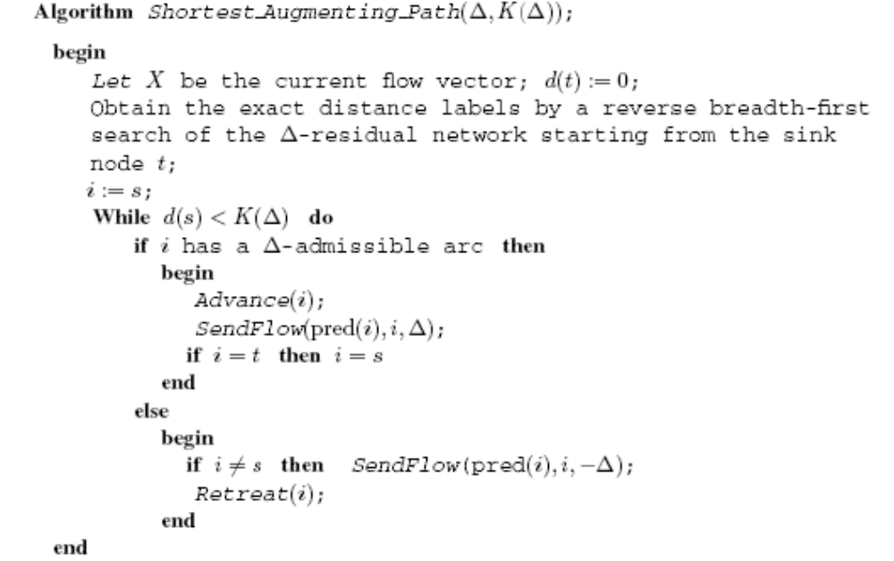

Slide 17


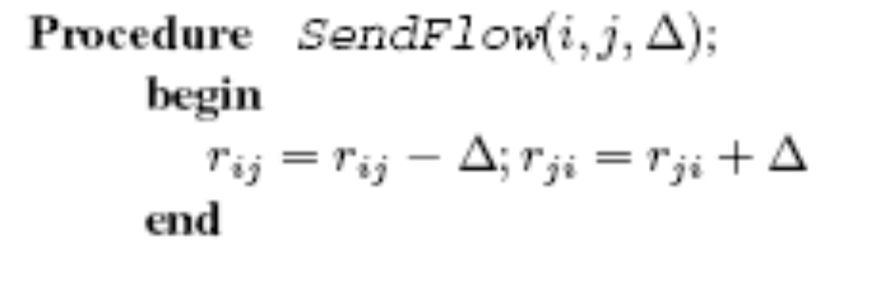

Slide 18
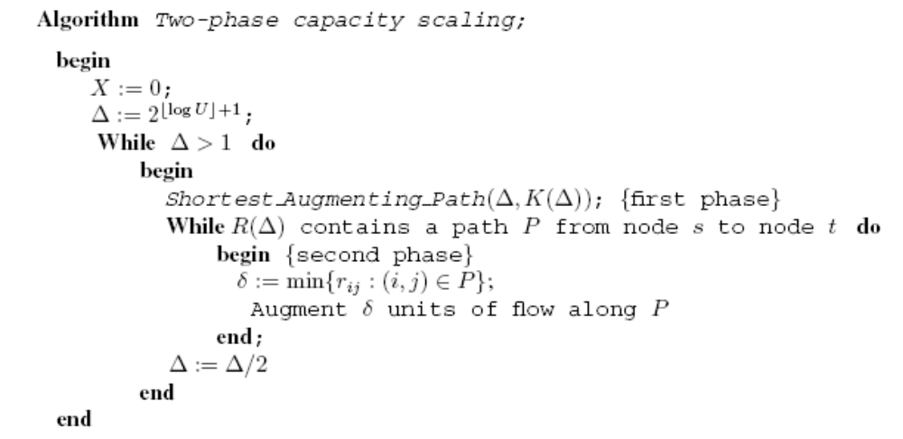
phase 1
phase 2

Slide 19
Complexity of phase 1: O(mK(∆))
# of Retreat
  O(nK(∆))
Total effort spent in Retreat
  O(mK(∆))
∆-saturating push of an arc (i,j)
  the residual capacity of the arc becomes less than after the push of flow on arc
# of ∆-saturating push
  O(mK(∆)/2)
# and total effort of augmentation
  O(mK(∆))

Slide 20
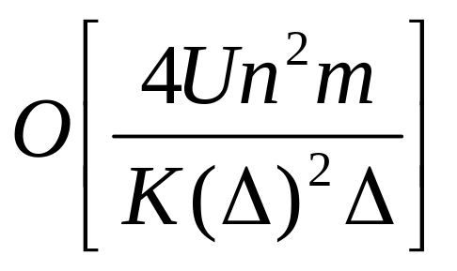
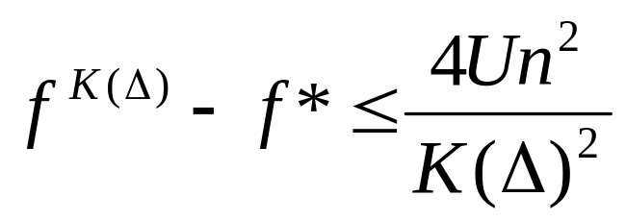
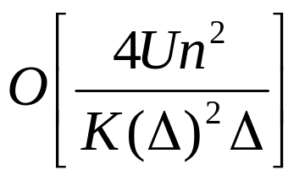
Complexity of phase 2
f^{K(∆)} denotes the flow value at the end of the first phase and f* denotes the ∆ -optimal flow value
Each augmentation sends at least ∆ units of flow
# of augmentation is at most
O(m) for each augmentation

Slide 21
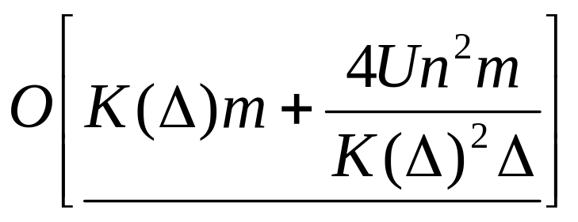
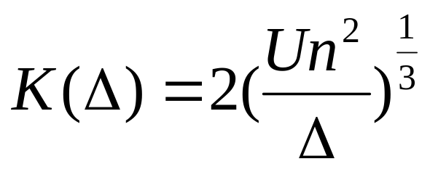
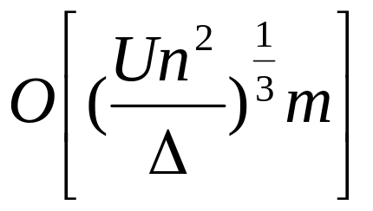
Complexity of a scaling phase
phase 1 + phase 2
This function has a minimum at

Slide 22
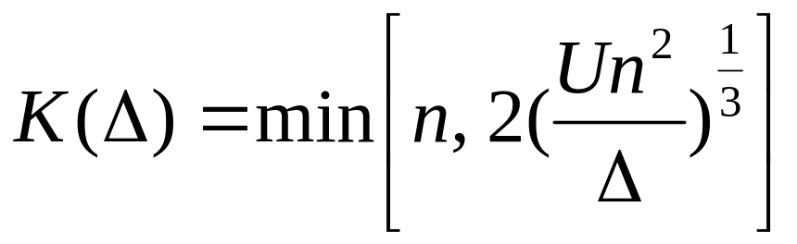
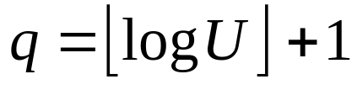

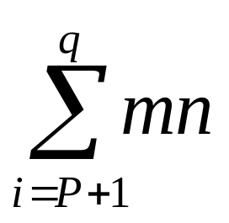
Complexity of the 2-phase algorithm
Strategy for selecting K(∆)
  K(∆) increases while ∆ decreases
The algorithm performs q scaling phases
After the p-th scaling phase , only the first shortest augmentation path algorithm is needed

Slide 23
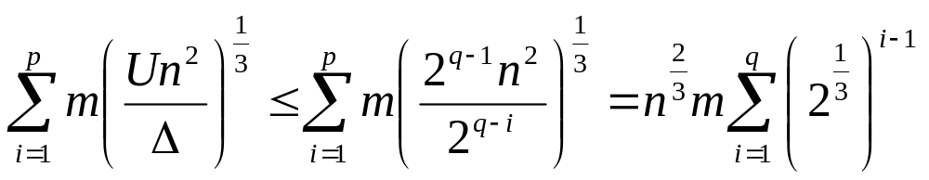
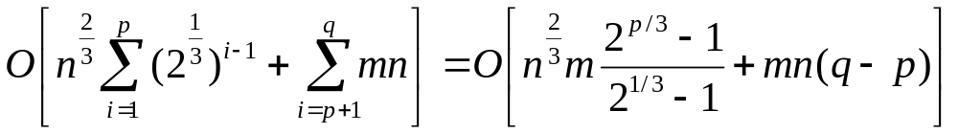
Complexity of the 2-phase algorithm
Before the p-th scaling phase, K(∆) < n
Total complexity

Slide 24
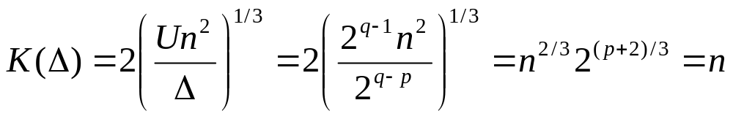
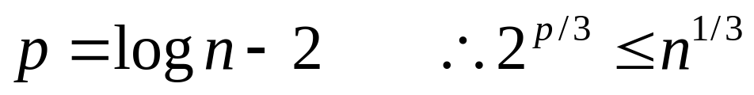
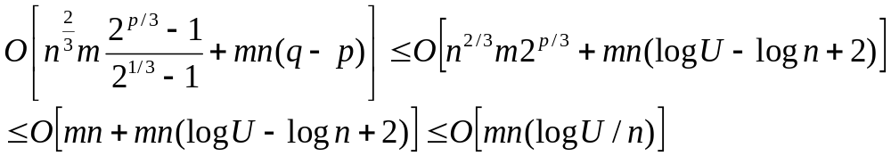
Complexity of the 2-phase algorithm
  How to determine p?
  Total complexity

Slide 25
Conclusion
A 2-phase capacity scaling algorithm is proposed
Computational experiments showed
  the capacity scaling algorithm of Ahuja and Orlin is faster than the proposed algorithm
  the capacity scaling algorithm performs fewer augmentations than the proposed algorithm

